Slide 1
Fundamental of Machine Learning

Slide 2
Machine Learning
Subset of AI
Computers perform tasks without explicit instructions
Algorithms learn from data and can even generalize to unseen data
Applied widely: computer vision, speech recognition, email filtering, agriculture, medicine, natural language processing (ChatGPT)

Slide 3
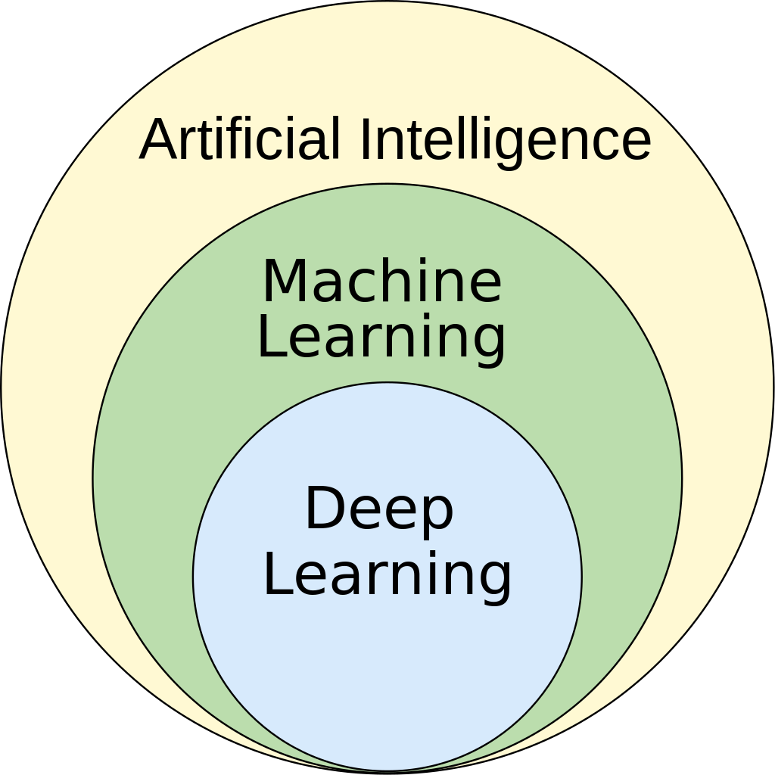

Slide 4
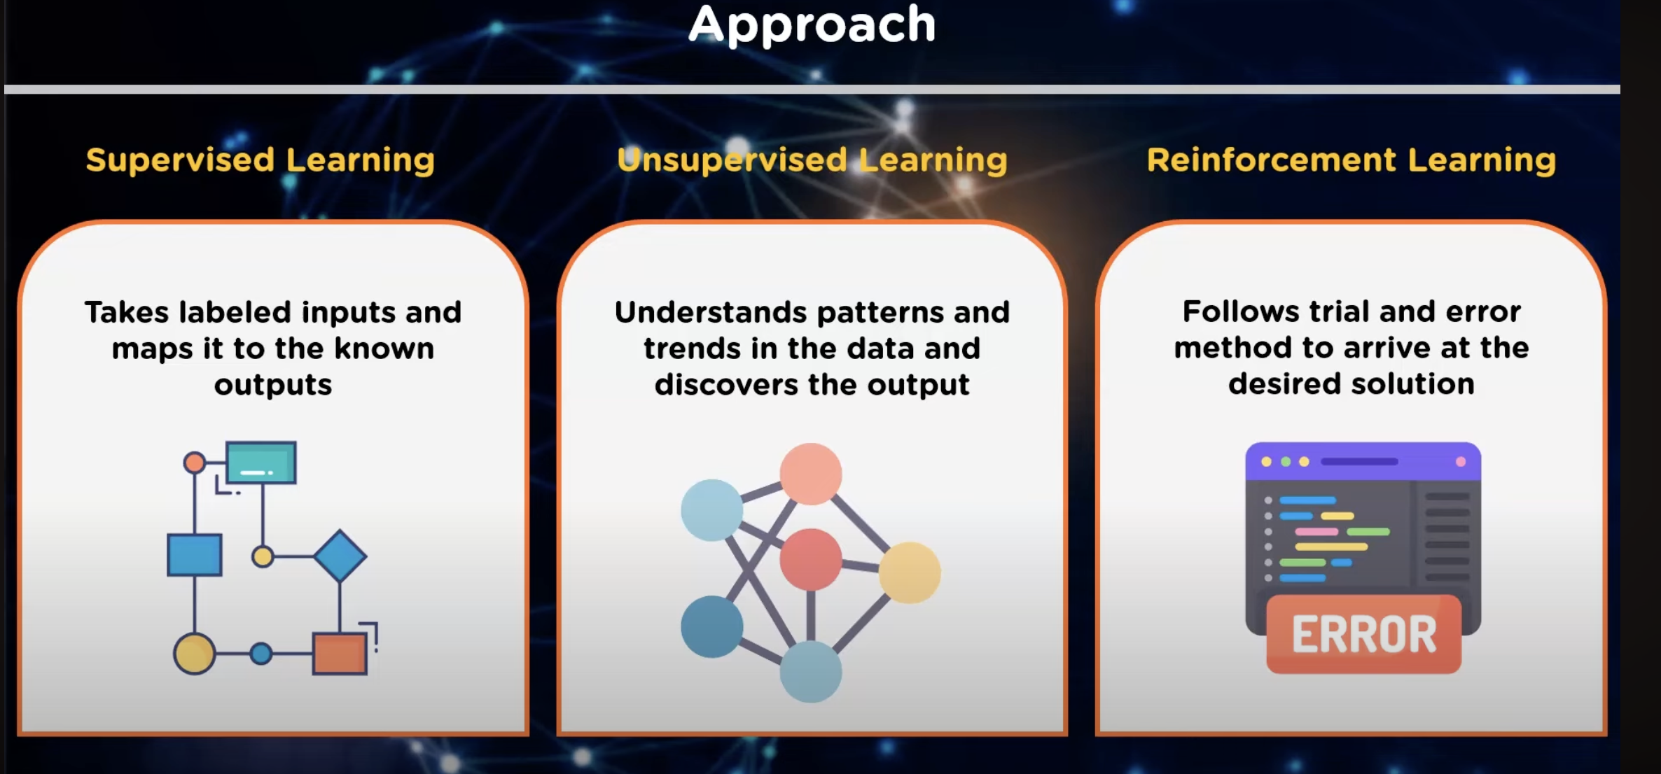
source: edureka

Slide 5
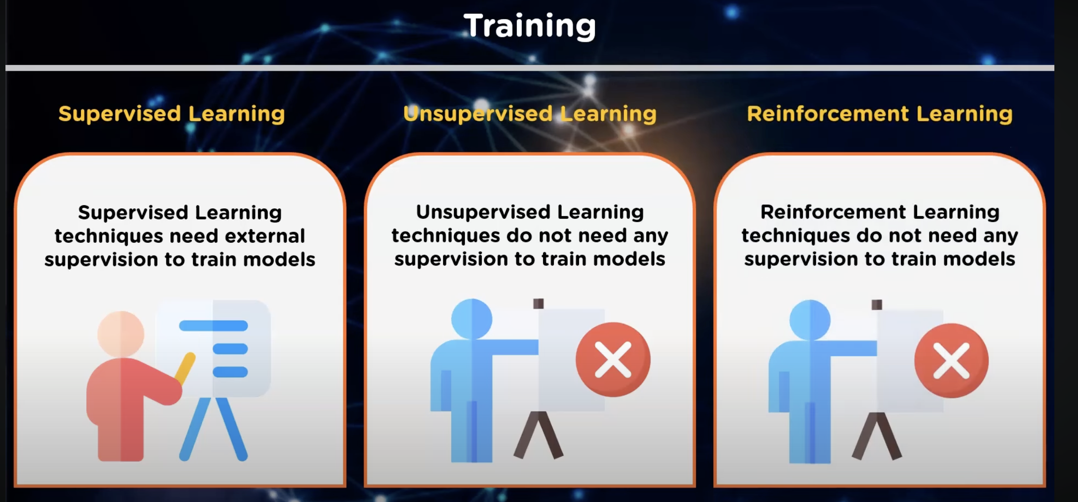
source: edureka

Slide 6
Examples of supervised learning
Email Spam Detetection
Medical Diagnosis using patient data to train the model to accurately predict the presence or absence of particular disease or condition based on the input features
Image Classification: training using labeled images (e.g cat, dog, car)
Language Translation

Slide 7
Examples of unsupervised learning
Clustering algorithms to point similar data (K-Means Clustering)
Anomaly Detection by identifying instances in a dataset that deviate significantly from the norm.
Generative Modeling (like ChatGPT, however it can fine-tuned on supervised tasks if needed)

Slide 8
Example of reinforcement learning
Reward for Certain Actions!
Games Examples: AlphaGo, OpenAI’s Dota2
Robotics: robots might learn to grasp objects or navigate through a cluttered environment
Recommendation Systems
https://www.youtube.com/watch?v=kopoLzvh5jY

Slide 9
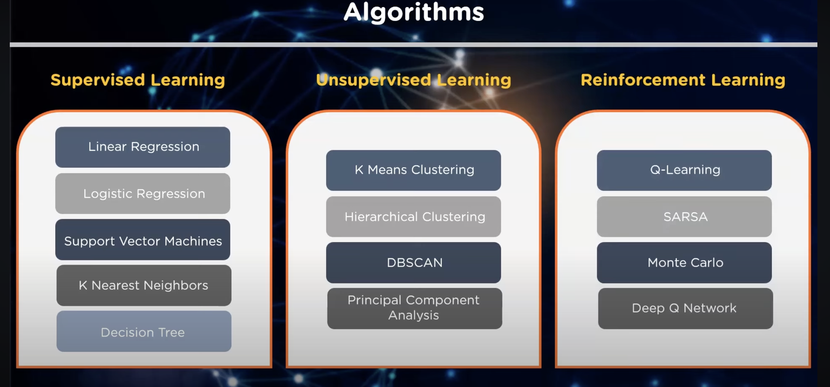
source: edureka

Slide 10
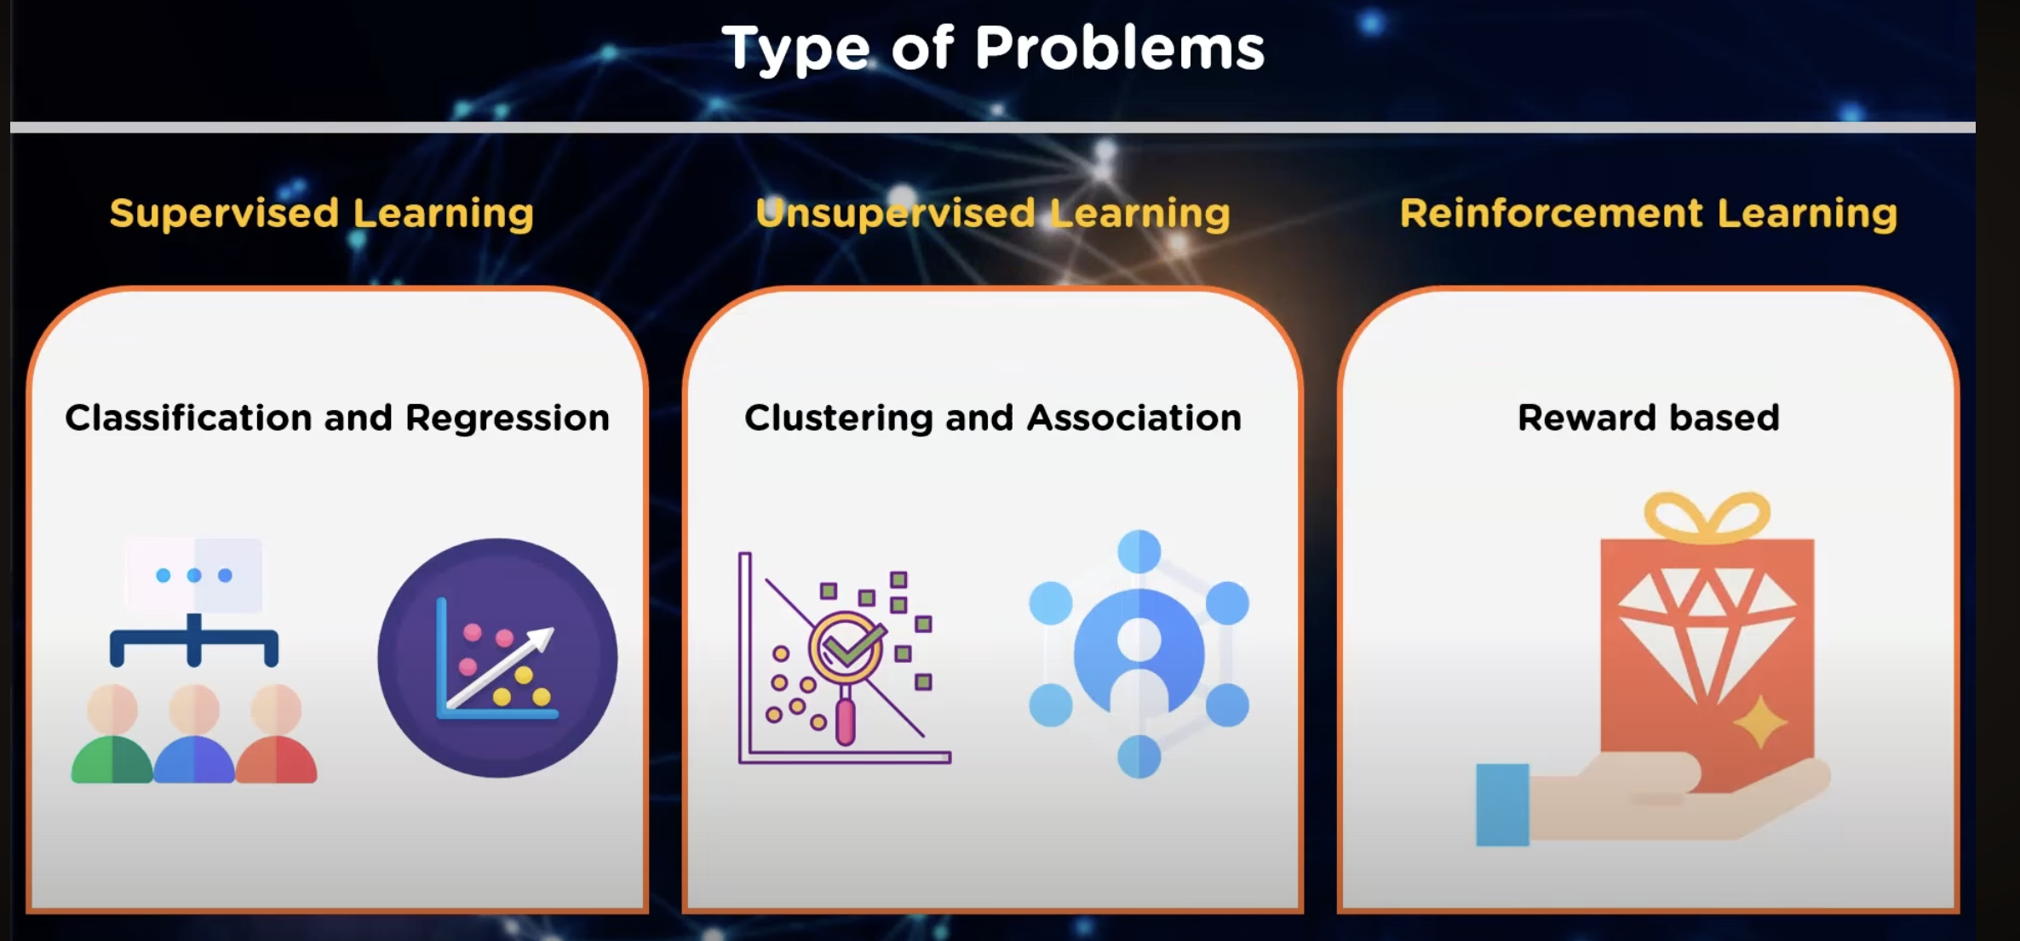
source: edureka

Slide 11
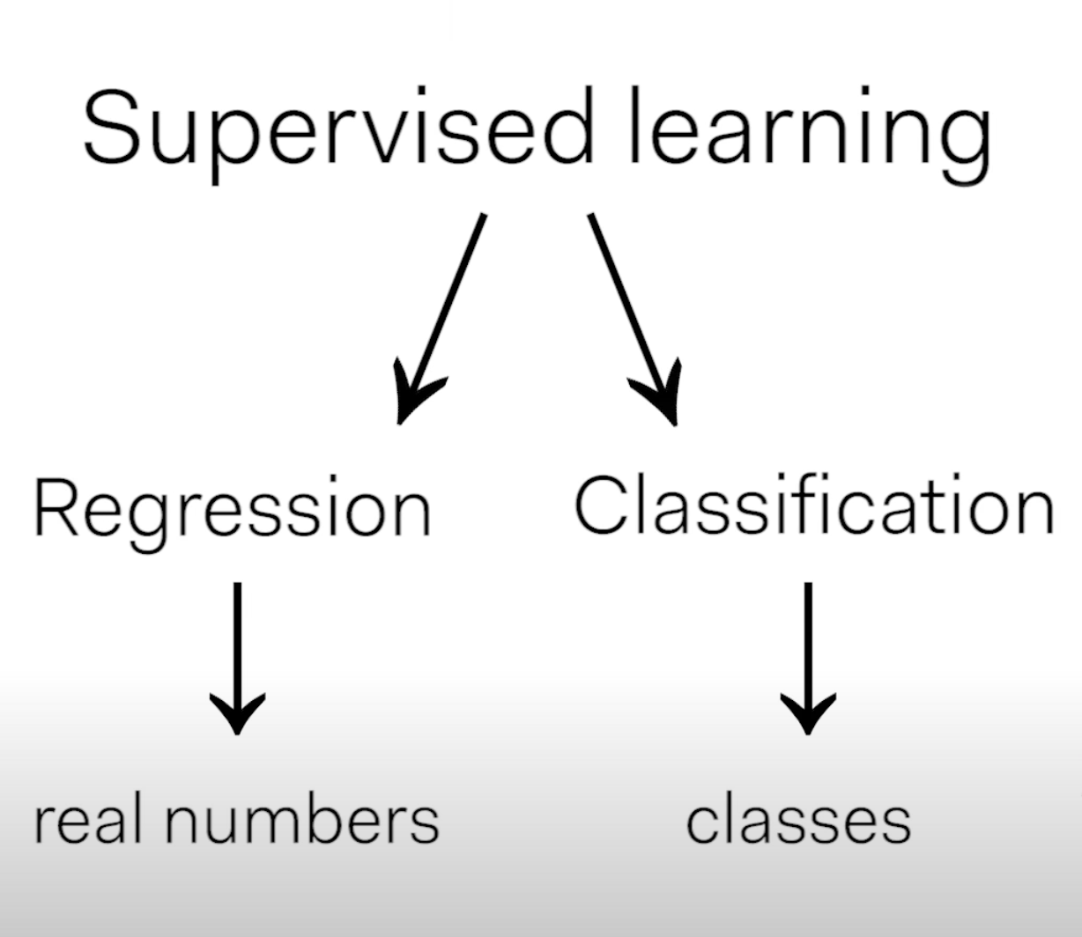

Slide 12
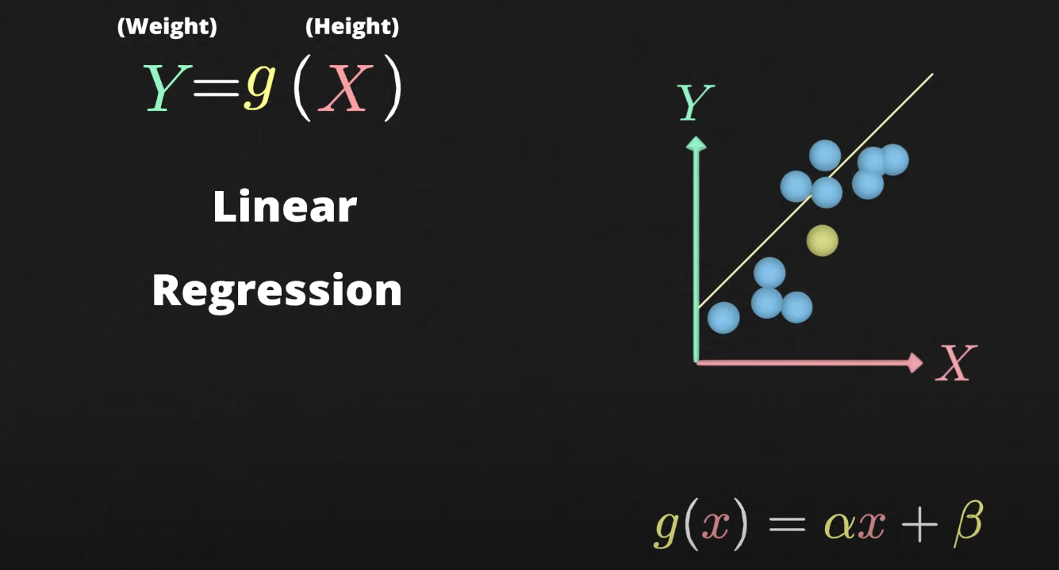
https://www.youtube.com/watch?v=CtsRRUddV2s

Slide 13
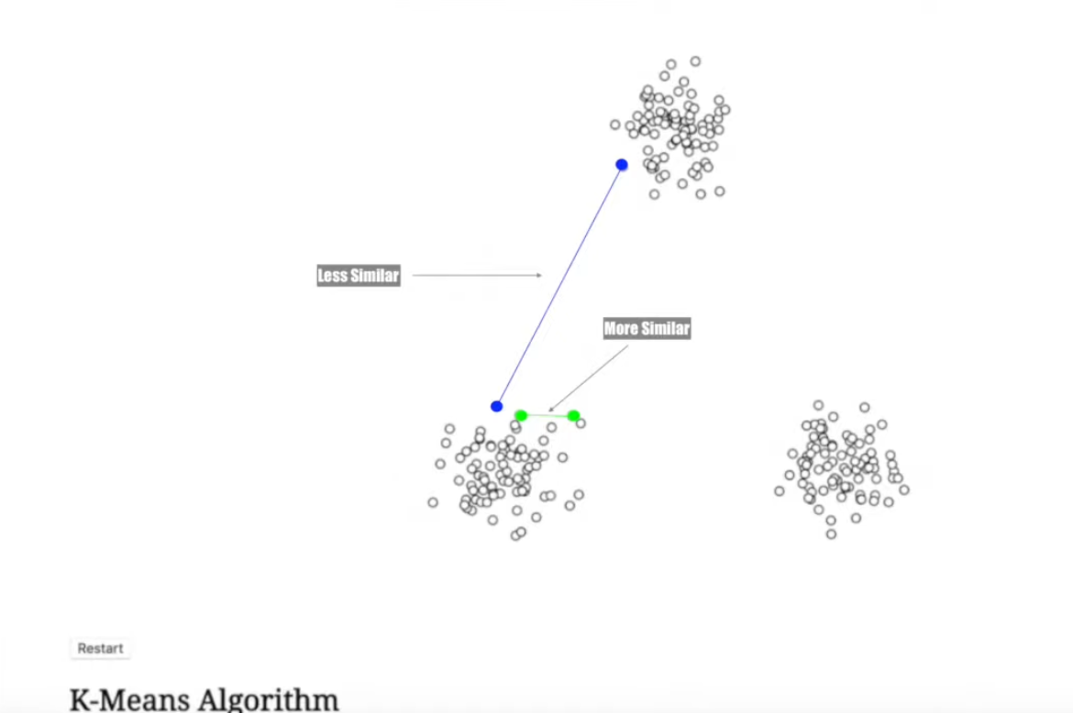
Clustering

